Slide 1
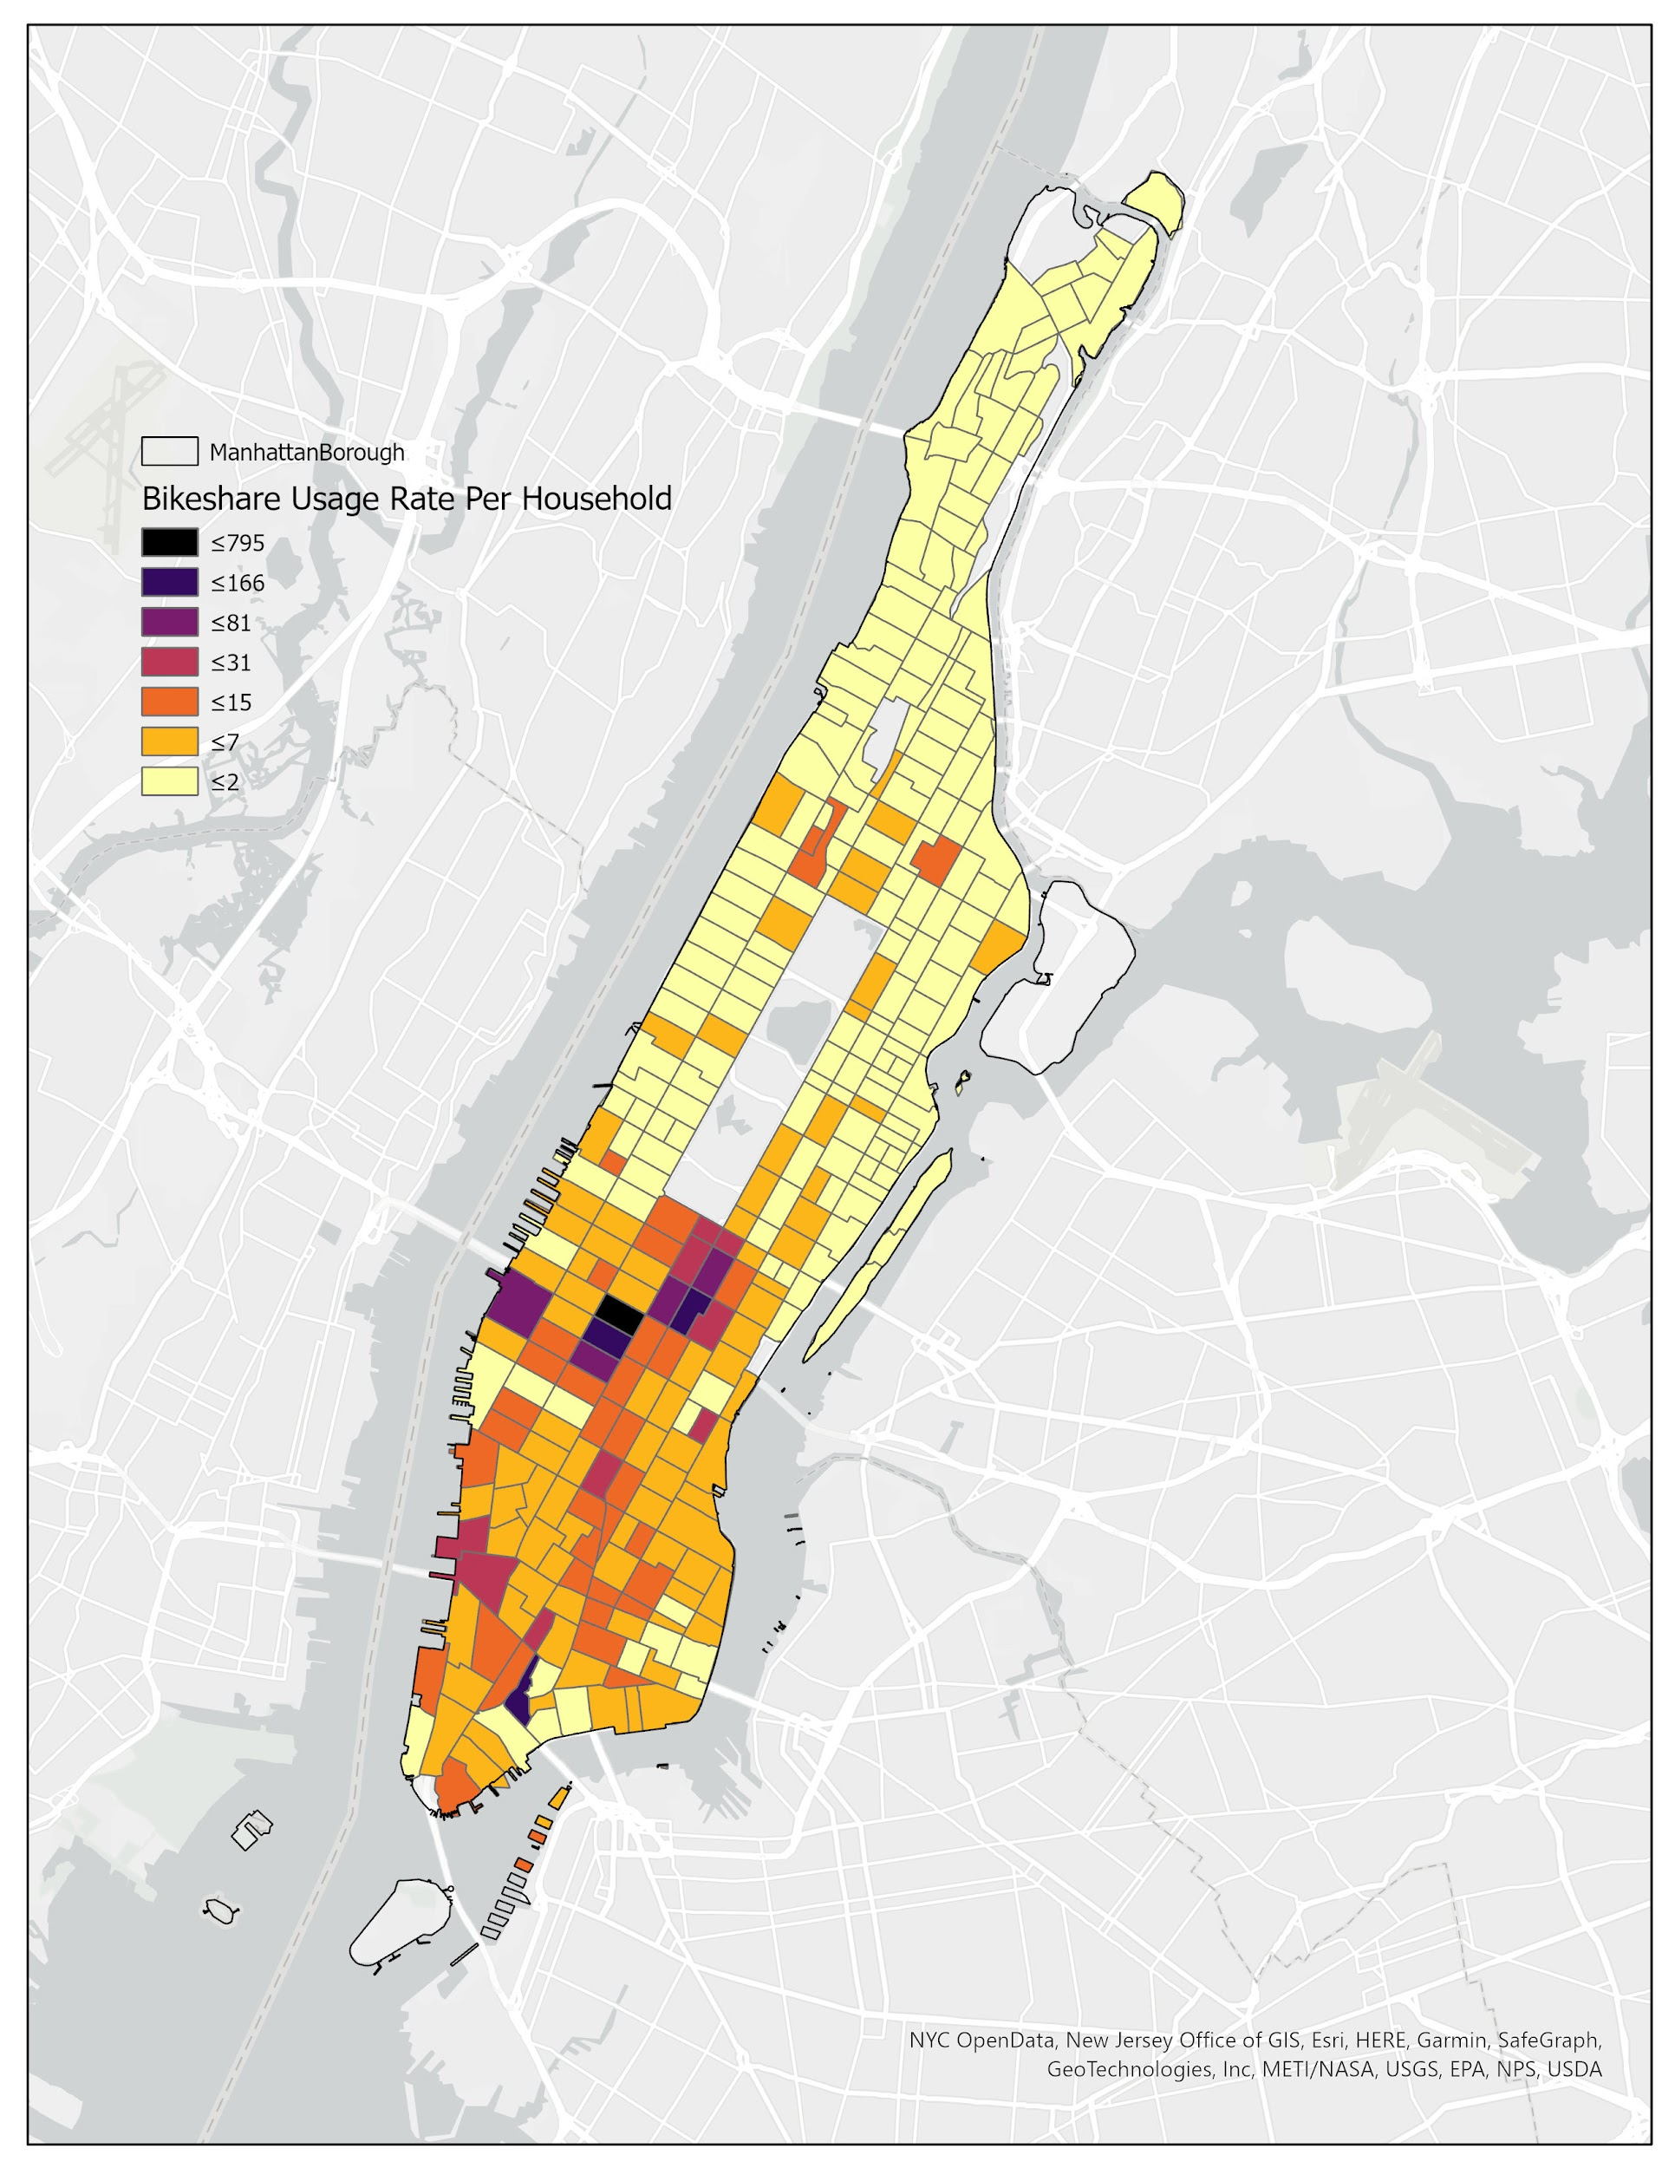
Unlocking Citi Bike's Potential: Data-Driven Insights for Growth
Analyzing Usage Patterns to Optimize Marketing and Operations

Slide 2
Table of Contents
01
Understanding Our Riders
02
Popular Pick-Up Locations
03
Trip Duration by Age
04
Top Rental Age Group
05
Weekday Usage: Subscribers vs. One-Time Users
06
Age and Trip Duration: The Correlation
07
Key Findings Summary
08
Actionable Recommendations
09
Next Steps & Q&A

Slide 3
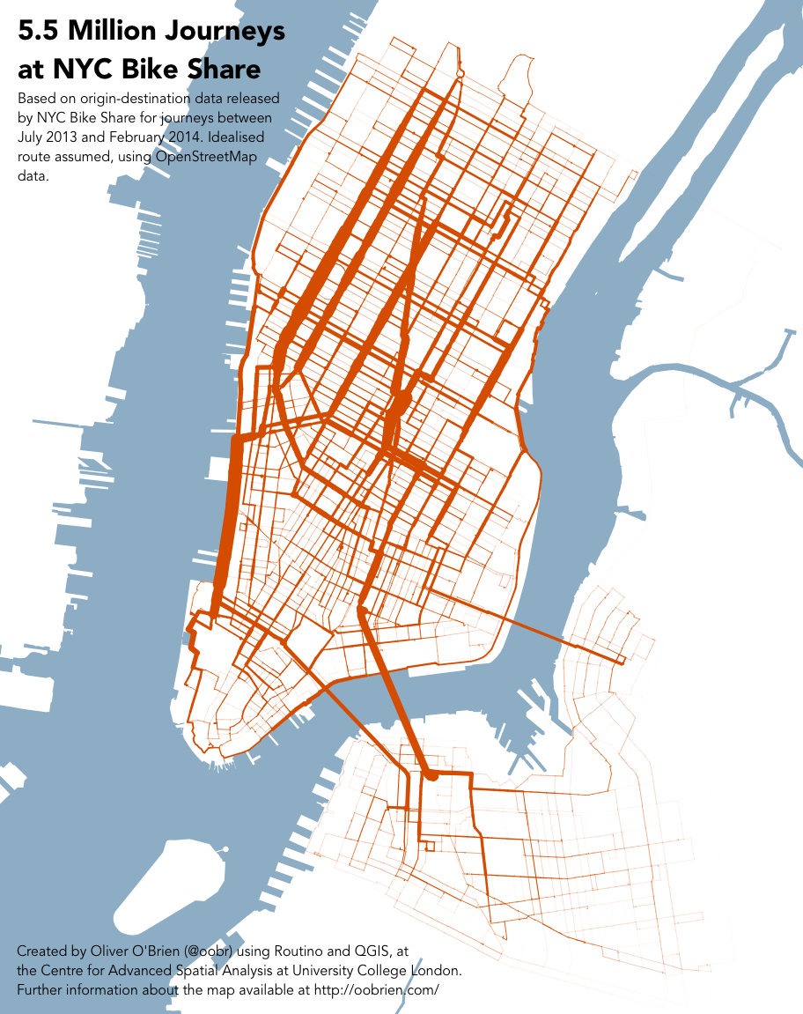
Understanding Our Riders
Who uses Citi Bike and why?
25–34 Year‑Old Professionals (≈40% of rides): • Daily commuters and social riders seeking fast, reliable transport.
18–24 Students & Young Adults: • Short‑hop trips to campus, errands, and nightlife hotspots.
55+ Leisure & Fitness Enthusiasts: • Longer scenic rides for wellness and sightseeing.
Subscribers vs. One‑Time Users: • Subscribers (70% weekday rides): Regular commuters optimizing cost and convenience. • One‑Time Users (weekend spikes): Tourists and casual explorers sampling the city.
Insight: Diverse age and usage profiles demand segmented marketing, tailored app experiences, and station planning to meet both commuter and leisure needs.

Slide 4
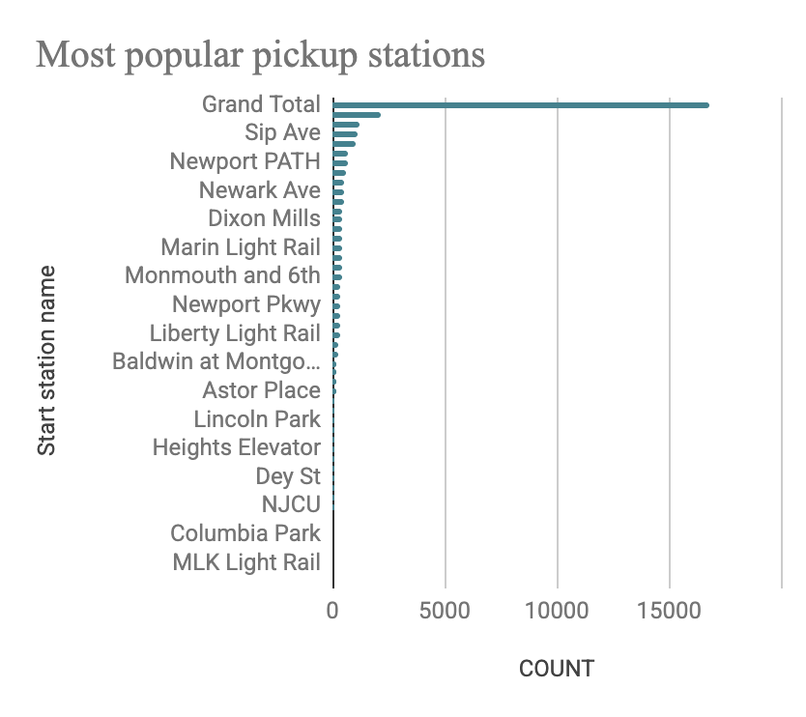
Popular Pick-Up Locations
Where do most rentals begin?
Key Insight Based on Jan–Mar 2025 data, the top five pick‑up stations are:
Grove St PATH – 2,115 rides
Exchange Place – 1,224 rides
Sip Ave – 1,084 rides
Hamilton Park – 1,069 rides
These stations outpace others by 30–70% in
daily departures, driven largely by their proximity to
transit hubs & popular waterfront destinations.
Why It Matters
Signals where unmet demand creates wait‑times & lost revenue
Informs precise rebalancing and expansion priorities
Highlights neighborhoods for geo‑targeted marketing
Action Points
Bike Redistribution: Stage an additional 15–20% of fleet at these five stations 30 minutes before AM and PM peak windows.
Dock Expansion Pilot: Fast‑track approval for 10–15 extra docks at Grove St PATH and Exchange Place.
On‑Site Promotions: Install QR‑code kiosks with first‑ride discounts and app‑upgrade prompts at these hotspots.

Slide 5
Age Grp | Trip duration
Grand Total | 9
75+ | 49
65-74 | 7
55-64 | 9
45-54 | 8
35-44 | 9
25-34 | 9
18-24 | 12
Trip Duration by Age
How long are rides, based on age?
Key Insight:
18–24: ~12 min avg | 55+: ~18 min avg
Why It Matters:
Different ride‑length needs—commute vs. leisure
Action Points:
Launch “50+ Scenic Route Challenge”
Add “Recommended Trips” loops (15–20 min) in app
Introduce “Long‑Ride Day Pass” for unlimited >15 min rides

Slide 6
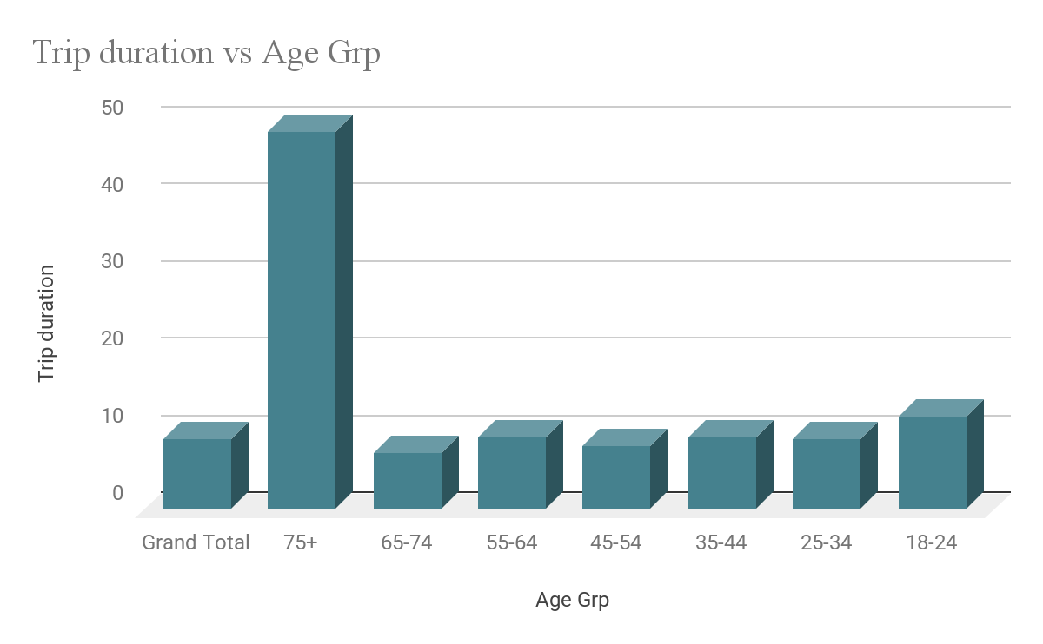
Top Rental Age Group
Which demographic rents most?
Key Insight:
25–34 year‑olds account for ~40% of total rides
Why It Matters:
Core audience for membership and upsell
Action Points:
After‑Work Happy Hour: 30 min free (5–7 PM weekdays)
Loyalty tier for ≥20 rides/month (fee waivers)
Partnership with coworking spaces for bundled deals

Slide 7
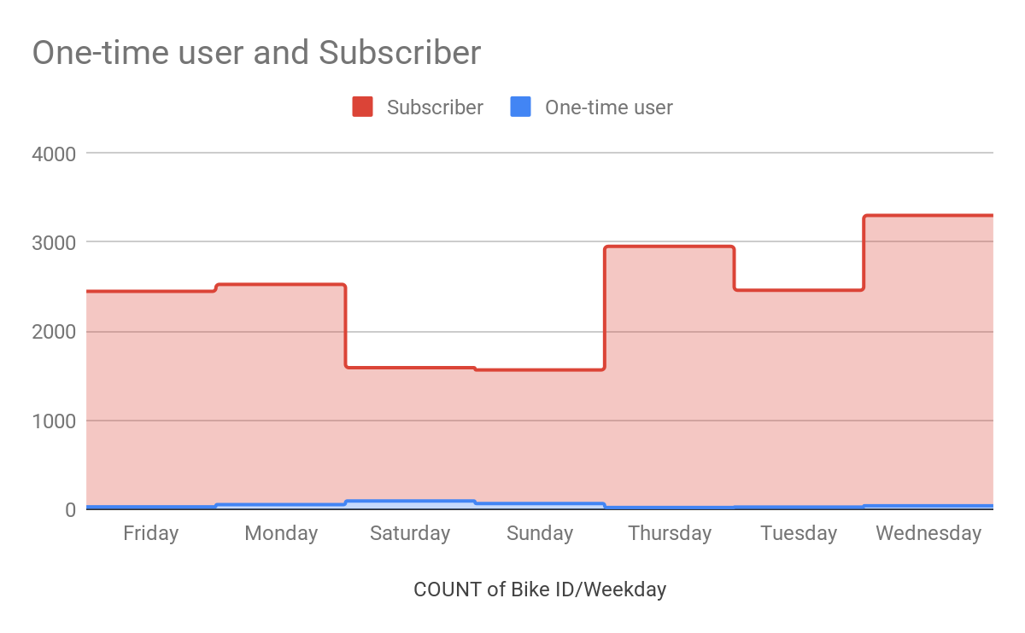
Weekday Usage: Subscribers vs. One-Time Users
How do usage patterns differ?
Key Insight:
Subscribers dominate Mon–Fri (70%);
One‑timers spike Sat–Sun
Why It Matters:
Tailor marketing by segment and day
Action Points:
“Weekend Explorer” discounts via travel apps
“Subscriber Sundays”: +10 min free every Sunday
Weekend support van in Central Park

Slide 8
Age Grp | Count of Bike ID
Grand Total | 16843
35-44 | 7697
25-34 | 4002
45-54 | 2973
55-64 | 1447
65-74 | 615
75+ | 55
18-24 | 54
Does Age Impact Trip Duration?
Does age affect ride length?
Key Insight:
Moderate positive correlation (r≈0.35): older → longer rides
Clear correlation: older users = longer ride duration
Exception: 65–74 drop (possibly due to comfort or availability)
Why It Matters:
Influences pricing, app features & partner programs
Action Points:
Tag routes by “Difficulty” & “Scenic Value” in app
Pilot “Health Partner” subsidized passes (gyms, clinics)
In‑app “Safe Night Rides” tutorials for older riders

Slide 9
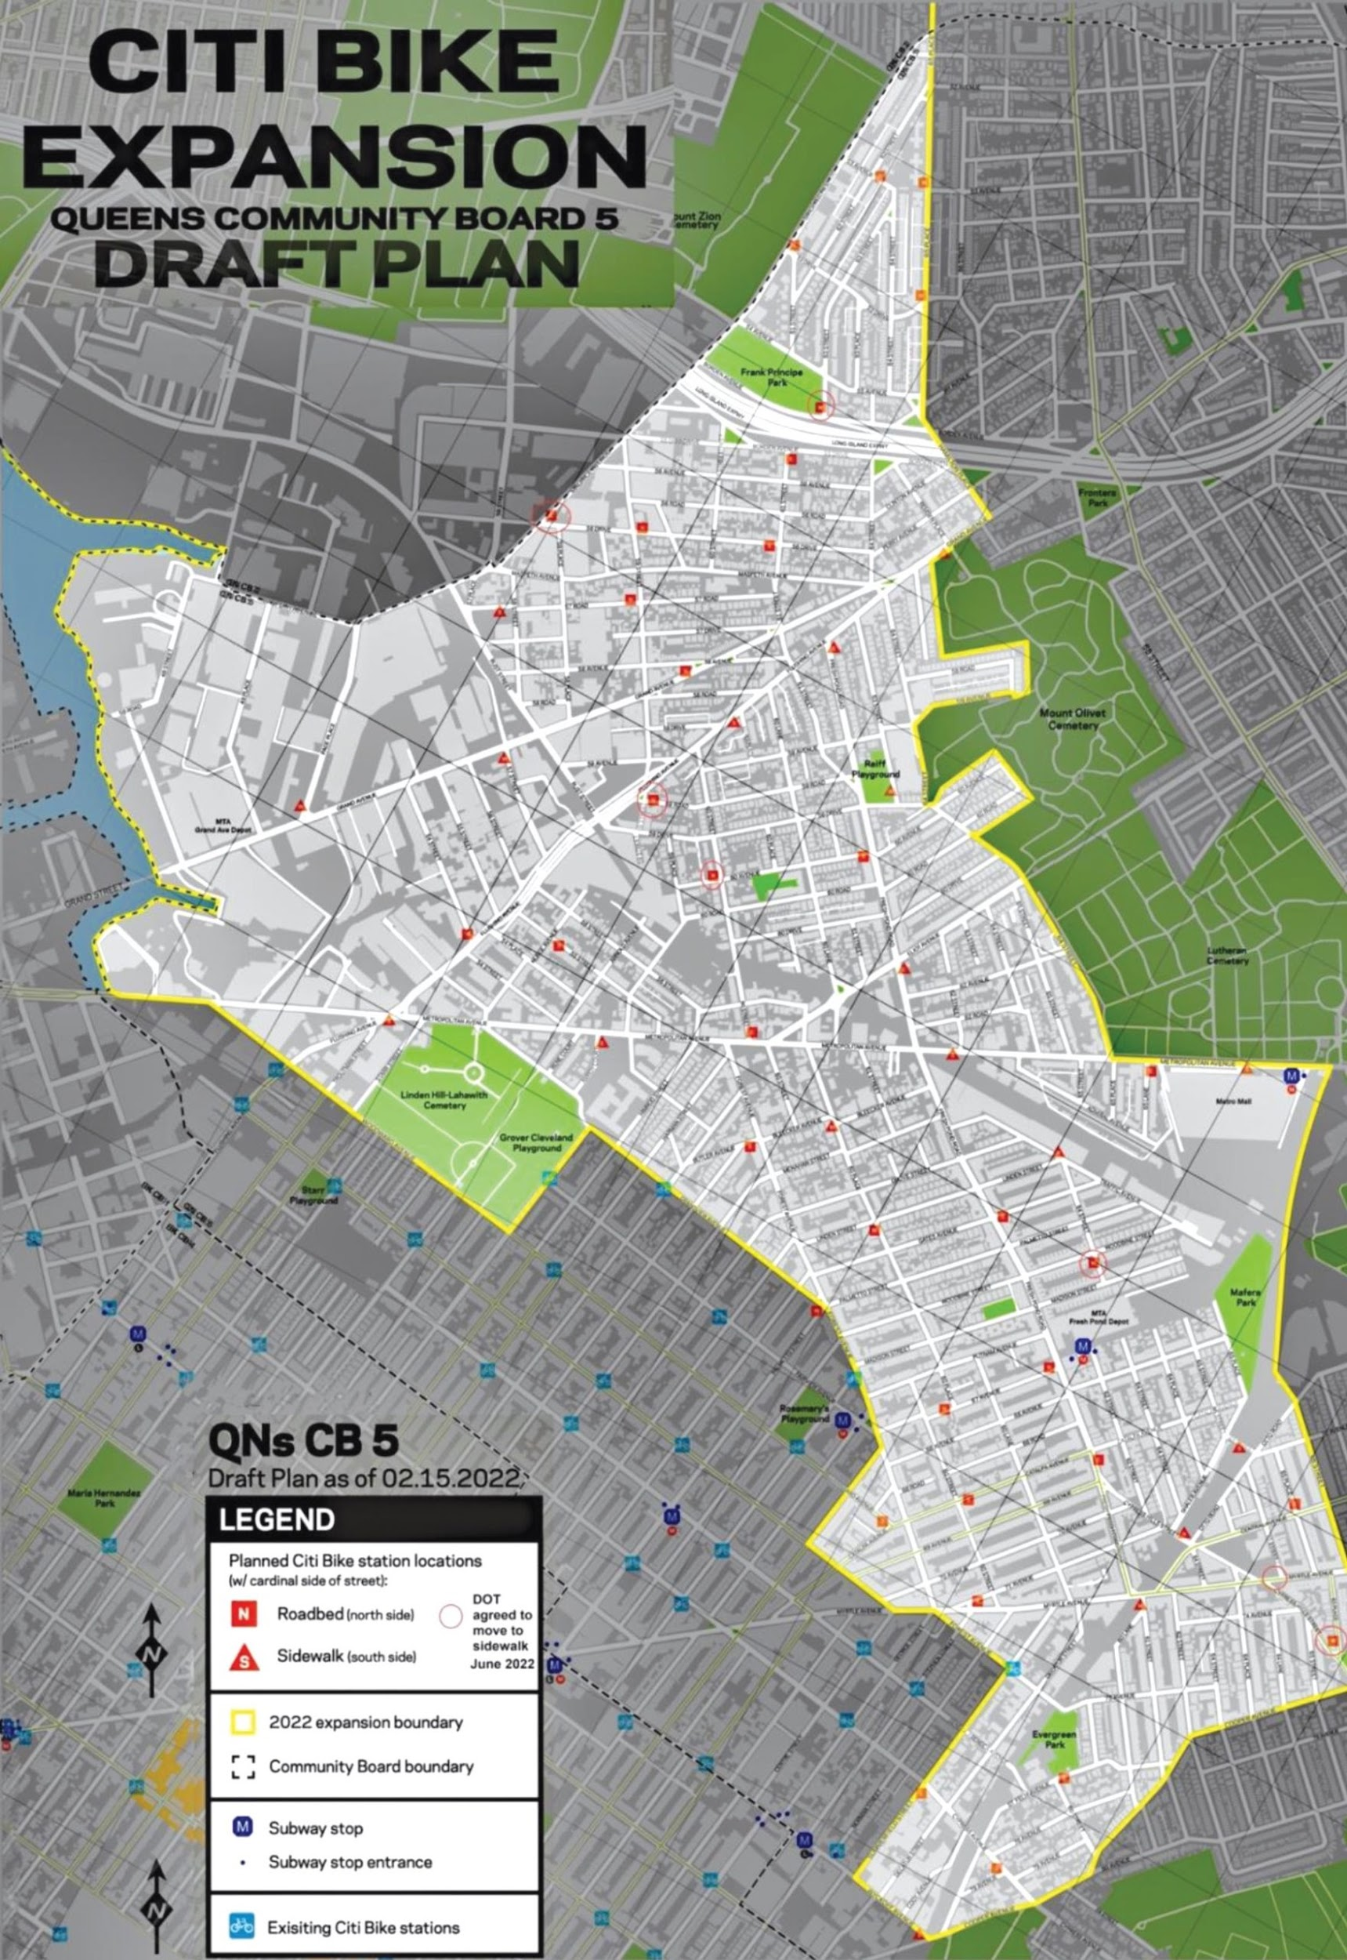
Key Findings Summary
Recap of our data insights
Redistribution & Expansion: Focus on identified hotspots
Targeted Campaigns:
Young professionals (25–34) & older leisure riders (55+)
Product Enhancements:
Scenic/fitness route suggestions & tiered passes
Service Excellence:
Weekend tourist support & age‑friendly tutorials
Strategic Partnerships:
Health insurers, coworking spaces, tourism platforms

Slide 10
Actionable Recommendations
Steps for growth and optimization
Targeted Age‑Specific Campaigns Leverage usage insights to craft tailored messages: fitness‑focused promotions for the 55+ segment, commuter perks for 25–34 year‑olds, and social‑ride bundles for 18–24 riders.
High‑Demand Station Roll‑Out Accelerate kiosk and dock installations in Midtown East, Financial District, and Williamsburg waterfront to meet peak demand and reduce wait times.
Personalized User Experiences Enhance the app with age‑based route recommendations and trip‑duration “challenges” (e.g. 15‑minute scenic loops for older users, quick‑hop commuter routes for younger riders).
Convert One‑Timers into Subscribers Introduce weekend trial passes, in‑app subscription prompts after second ride, and exclusive subscriber benefits (e.g. bonus minutes, priority support) to drive long‑term loyalty.

Slide 11
Next Steps & Q&A
Let's discuss the future of Citi Bike
Deepen Our Insights Expand our data lens to include rider feedback, weather patterns, and event-based traffic to better predict usage surges and preferences.
Turn Strategy into Impact Implement age-specific campaigns, optimize station placements, and personalize ride experiences based on data-backed insights.
Collaborate for Success Cross-functional alignment—marketing, operations, product, and customer service—is key to scaling sustainably and delighting every rider.
Open Dialogue We value your questions, feedback, and strategic ideas. Let’s co-create the next wave of smart, rider-first urban mobility.

Slide 12
Thank You!

